Slide 1
Ulwazi mayelana nocansi lwesitho sangasese sangemuva

Slide 2
Luyini ucansi lwesitho sangasese sangemuva?
Ucansi lwesitho sangasese sangemuva kulapho owesilisa efaka isitho sakhe sangasese sangaphambili esithweni sangasese sangemuva sikaphathina wakhe.
Notes:
Lokhu akufani nangesikhathi isitho sangasese sangaphambili sowesilisa sifakwa esithweni sangasese sangaphambili sowesifazane “eqhamuka ngasemuva”.

Slide 3
Ubani owenza ucansi lwesitho sangasese sangemuva?
Nakuba abantu abaningi behlazeka ngokukhuluma ngalo, izinhlobo eziningi zabantu ziyalwenza ucansi lwesitho sangasese sangemuva.

Slide 4
Abesillisa nabesifazane bayalenza ucansi lwesitho sangasese sangasemuva, kungakhathalekile ukuthi uthanda ubulili obunjani kwezocansi.
Ubani owenza ucansi lwesitho sangasese sangemuva?

Slide 5
Yini abantu bangahle benze ucansi lwesitho sangasese sangemuva?

Slide 6
Ziningi izizathu ezenza abantu bazibandakanye ocansini lwesitho sangasese sangemuva, okunye khwakho kuhlanganisa:
ukulangazelela ukuzwa
ubumnandi
isizungu
ukushesha uchame
umuzwa obambayo
ukujabulisa uphathina
imali
ngesikhathi sokukhulelwa noma sokuba sesikhathini
njengendlela yokuvikela ukukhulelwa
ukugcina ubuntombi noma ubunsizwa bakho
ukwandisa umuzwa wokusondelana
kanye nezinye izizathu eziningi

Slide 7
Ingabe Igciwane lesandulela ngculazi lingadluliseka yini ngocansi lwesitho sangasese sangemuva?
Yebo.
Empeleni, ucansi lwesitho sangasese lwangemuva olungavikelekile lubeka abantu ebungozini obukhulu bokuthola ingciwane lesandulela ngculazi kunanoma iyiphi enye indlela yokuziphatha ngokocansi.
Ucansi lwesitho sangasese sangemuva olungavikelekile lunobungozi kwabesifazane kunocansi lwesitho sangasese sangaphambili sowesifazane olungavikelekile uma kuziwa ekutholeni ingciwane lesandulela ngculazi nezinye izifo ezidluliseka ngokocansi.

Slide 8
Kungani ucansi lwesitho sangasese sangemuva olungavikelekile lunobungozi kangaka?
Igciwane lesandulela ngculazi ligadluliseka kalula ngocansi lwesitho sangasese sangemuva ngoba isicubu sesitho sangasese sangemuva sintekenteke kakhulu futhi asinazo izithambisi zemvelo.
Isicubu sesitho sangasese sangemuva silimala kalula ngesikhathi kwenziwa ucansi lwesitho sangasese sangemuva olungenazo izithambisi, okwenza indlela elula yokungena kwegciwane lesandulela ngculazi.

Slide 9
Ngingazivikela kanjani kwigcikwane lesandulela ngculazi ngesikhathi socansi lwesitho sangasese sangasemuva?

Slide 10
Ngingazivikela kanjani kwigcikwane
lesandulela ngculazi ngesikhathi socansi
lwesitho sangasese sangasemuva?
Indlela engcono yokuzivikela kwigcikwane lesandulela nculazi ngesikhathi wenza ucansi lwesitho sangasese sangemuva ukusebenzisa amakhondomu kanye nesithambisi esinesisekelo samanzi (njenge KY jelly).
Uketshezi lokuthambisa olunesisekelo samafutha (njengo Vaseline noma iloshini yomzimba) luyawalimaza amakhondomu futhi akufanele kusetshenziswe.
Notes:
Ezinye izindlela zokunciphisa ubungozi zibandakanya ukunciphisa isibalo sophathina bocansi futhi basebenzise ezinye izindlela zokuziphatha ngokocansi ezinobungozi obungaphansi kunocansi lwesitho sangasese sangemuva.

Slide 11
Akwaziwa noma ukusebenzisa iringi enedapivirine esithweni sangasese sangaphambili sowesifazane kunikeza ukuvikeleka ekutholeni ukutheleleka ngegcikwane lesandulela ngculazi uma wenza ucansi lwesitho sangasese sangemuva. Iringi akumele ishuthekwe esithweni sangasese sangemuva.
Ngingazivikela kanjani kwigcikwane
lesandulela ngculazi ngesikhathi socansi
lwesitho sangasese sangasemuva?

Slide 12
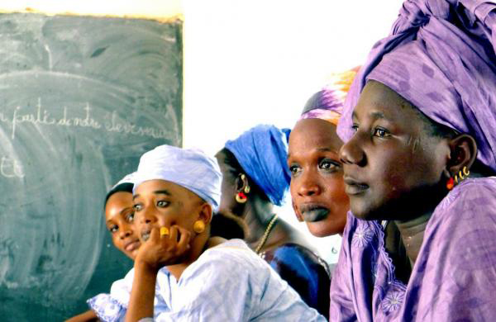
Kubaluleke ngani ukukhuluma ngocansi lwesitho sangasese sangemuva kuHOPE?

Slide 13
Kubaluleke ngani ukukhuluma ngocansi lwesitho sangasese sangemuva kuHOPE?
Abesifazane nabesilisa abaningi abanalwazi ukuthi ucansi lwesitho sangasese sangemuva olungavikelekile lubabeka engcupheni ephezulu kwigcikwane lesandulela ngculazi kanye nezinye izifo ezidluliseka ngokocansi.
Notes:
Abasebenzi bocwaningo bacela ukubikelwa ngokuvulelekile ngezenzo zocansi lwesitho sangasese sangemuva ukuqinisekisa ukuthi ababambiqhaza banolwazi abaludingayo ukuzivikela.
Iringi ayakhelwanga ukuvikela ekuthelelekeni ngegcikwane lesandulela ngculazi ngokwenza ucansi lwesitho sangasese sangemuva futhi akumele isetshenziswe esithweni sangasese sangemuva.
Uma umbambiqhaza etheleleka ngegcikwane lesandulela ngculazi ngesikhathi esocwaningweni, ukwazi ngezindlela zokuziphatha ngokocansi lwesitho sangasese sangemuva kuzosiza iqembu locwaningo ukuqonda ukuthi ngabe lokhu kutheleleka kwenzeke ngenxa yezindlela zocansi ezingavikelekile ngokusebenzisa iringi yesitho sangasese sangaphambili sowesifazane.

Slide 14
Abasebenzi bocwaningo bakhonela ukukusiza.
Abasebenzi bocwaningo bakhona ukukwazisa nokululeka ababambiqhaza bocwaningo, ophathina babo, kanye namanye amalunga omphakathi mayelana nocansi lwesitho sangasese sangemuva kanye nanoma imiphi imibuzo nokukhathazeka abangase babe nakho, futhi bazokwenza kanjalo ngendlela engenakho ukwahlulela.

Slide 15
Uma unemibuzo noma udinga ulwazi olwengeziwe, sicela uvakashele eklinikhi yocwaningo.

